Slide 1

DEPARTMENT OF COMPUTER SCIENCE & ENGINEERING BASIC COMPUTER ORGANIZATION AND DESIGN
Block Diagram of Computer-Instruction Codes – Computer Registers – Instruction Cycle – Memory reference Instructions – Input – Output and Interrupt Design of Basic Computer – ALU design.
By
Ms. Swetha.V
ASST.PROFESSOR

Slide 2
INSTRUCTION CODES
Instruction codes are nothing but the group of bits (1010111).
The instructions tells the processor to perform some specific task.
Computer instructions are a set of machine language instructions that a particular processor understands and executes

Slide 3
Instruction: a binary code that specifies a sequence of micro-operations for the computer.
Instruction Code: group of bits that instruct the computer to perform specific operation.

Slide 4
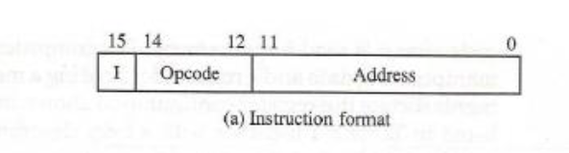
Instruction code is usually divided into three parts: Opcode and address(operand).
Mode represents the direct and indirect address.

Slide 5
Operation Code (opcode):
Group of bits that define the operation
eg: add, subtract, multiply, shift, complement.

Slide 6
ADDRESS (OPERAND):
Specifies the location of operands (registers or memory words)
Memory words are specified by their address.
Addressing of Operand is divided into two types:
Direct Address
Indirect Address

Slide 7
DIRECT ADDRESS
The instruction in address 22 in memory.
The I bit is 0, so the instruction is recognized as a direct address instruction.
The opcode specifies an ADD instruction, and the address part is the binary equivalent of 457.

Slide 8
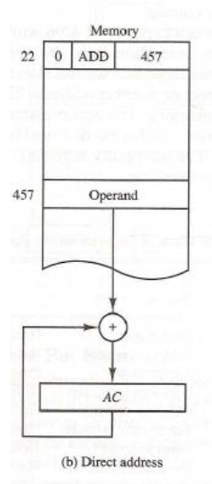

Slide 9
INDIRECT ADDRESS
The instruction in address 35 shown has a mode bit I = 1.
Therefore, it is recognized as an indirect address instruction.
The address part is the binary equivalent of 300. The control goes to address 300 to find the address of the operand.
The address of the operand in this case is 1350.
The operand found in address 1350 is then added to the content of AC.

Slide 10
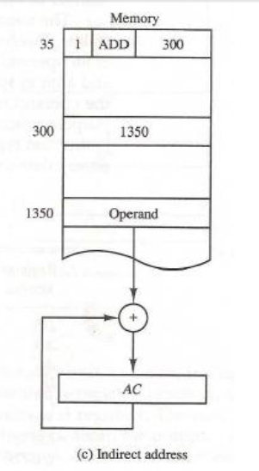

Slide 11
Quiz
SIZE OF A INSTRUCTION ______________
SIZE OF ADDRESS IN INSTRUCTION _______________
SIZE OF OPCODE IN INSTRUCTION ______________
SIZE OF MODE IN INSTRUCTION _____________
0 REPRESENTS ____________ ADDRESS.
1 REPRESENTS ____________ ADDRESS.

Slide 12
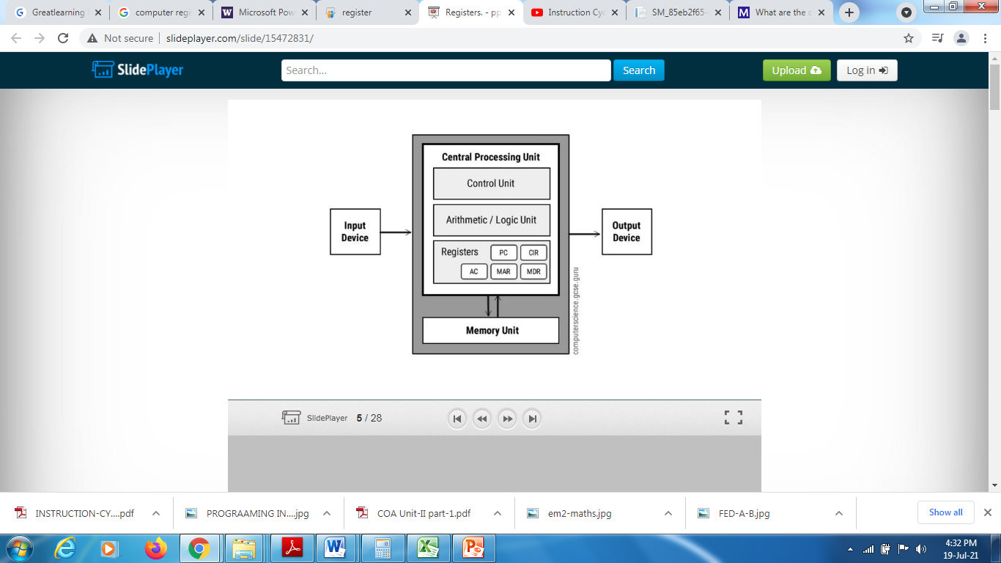
CPU REGISTERS

Slide 13
Computer Registers
Registers are a type of computer memory used to quickly accept, store, and transfer data and instructions that are being used immediately by the CPU.
The registers used by the CPU are often termed as Processor registers.
A processor register may hold an instruction, a storage address, or any data (such as bit sequence or individual characters).

Slide 14
CPU REGISTERS
From the Ram (Main memory) the data will be transferred to the cache memory inside the CPU.
From the Cache memory the datas are transferred to Registers.
The Registers are used to store the data which is to be executed by the CPU.

Slide 15
Registers is _______________ storage.
Register are available inside ______________.

Slide 16
DIFFERENT TYPES OF REGISTERS
Data Register
Address Register
Accumulator
Instruction Register
Program Register
Temporary Register
Input Register
Output Register

Slide 17
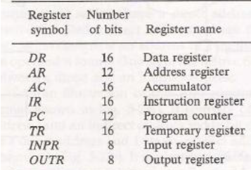
REGISTERS WITH ITS SIZE

Slide 18
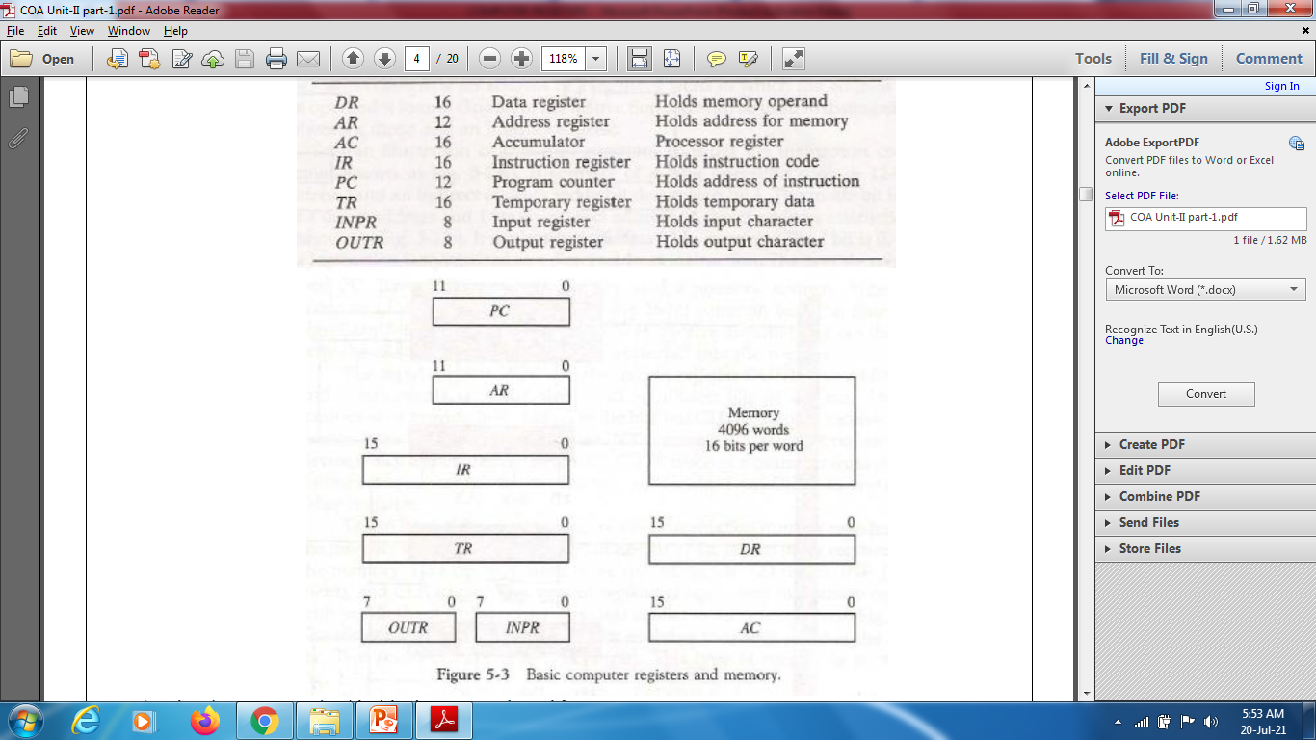
COMPUTER REGISTERS

Slide 19
PROGRAM COUNTER (PC)
PROGRAM COUNTER (PC) – it stores the address of the next instruction to be executed.
PROGRAM COUNTER (PC) – PC points to the address of the next instruction to be fetched from the main memory when the previous instruction has been successfully completed.

Slide 20
MEMORY ADDRESS REGISTER
Memory Address Register are those registers that holds the address for memory unit.
The Memory Address Register (MAR) contains 12 bits which hold the address for the memory location.
It holds the address of the location to be accessed from memory. MAR together facilitate the communication of the CPU and the main memory.

Slide 21
INSTRUCTION REGISTER (IR)
The instruction read from memory is placed in the Instruction register (IR).
Instruction Register holds the instruction to be executed.
The instruction from PC is fetched and stored in IR. As soon as the instruction in placed in IR, the CPU starts executing the instruction and the PC points to the next instruction to be executed.

Slide 22
Temporary Register (TR)
The Temporary Register (TR) is used for holding the temporary data during the processing.

Slide 23
The Input Registers (IR) holds the input characters given by the user.
The Output Registers (OR) holds the output after processing the input data.

Slide 24
Data Register (DR)
The Data Register (DR) contains 16 bits which hold the operand read from the memory location.
It contains data to be written into or to be read out from the addressed location.

Slide 25
ACCUMULATOR (AC)
The Accumulator (AC) register is a general purpose processing register.
An accumulator is a type of register included in a CPU.
It acts as a temporary storage location which holds an intermediate value in mathematical and logical calculations.
This is the most common register, used to store data taken out from the memory.

Slide 26
QUIZ
SIZE OF ADDRESS REGISTER _____________.
SIZE OF IR _______________.
SIZE OF DATA REGISTER ____________
REGISTER WHICH STORES THE ADDRESS OF NEXT INSTRUCTION _______________.
SIZE OF INPUT AND OUTPUT REGISTER _____________.
DIFFERENCE BETWEEN CACHE AND MAIN MEMORY.

Slide 27
Computer Instructions
Computer instructions are a set of machine language instructions that a particular processor understands and executes.
A computer performs tasks on the basis of the instruction provided.

Slide 28
Computer Instructions
An instruction comprises of groups called fields. These fields include:
The Operation code (Opcode) field which specifies the operation to be performed.
The Address field which contains the location of the operand, i.e., register or memory location.
The Mode field which specifies how the operand will be located.

Slide 29

Computer Instructions

Slide 30
INSTRUCTION TYPES
Computer instructions is divided into 3 types :
Memory reference instructions
Register reference instructions
I/P and O/P reference instructions

Slide 31
MEMORY - REFERENCE INSTRUCTION
In Memory-reference instruction, 12 bits of memory is used to specify an address and one bit to specify the addressing mode 'I'.

Slide 32
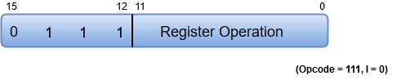
Register - reference instruction
The Register-reference instructions are represented by the Opcode 111 with a 0 in the leftmost bit (bit 15) of the instruction.
A Register-reference instruction specifies an operation on or a test of the AC (Accumulator) register.

Slide 33
INPUT-OUTPUT INSTRUCTION
Just like the Register-reference instruction, an Input-Output instruction does not need a reference to memory and is recognized by the operation code 111 with a 1 in the leftmost bit of the instruction.
The remaining 12 bits are used to specify the type of the input-output operation or test performed.

Slide 34
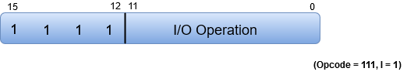
INPUT-OUTPUT INSTRUCTION

Slide 35
3 X 8 DECODER IS USED TO DECODE THE OPCODE
D0 – D7
D0 – D6 ------------→ MEMORY REFERNCE
D7 ----------→ I / O

Slide 36
MEMORY REFERENCE INSTRUCTIONS
There stay 7 memory reference instructions as mentioned below.
LDA
STA
AND
ADD
BUN
BSA
ISZ

Slide 37
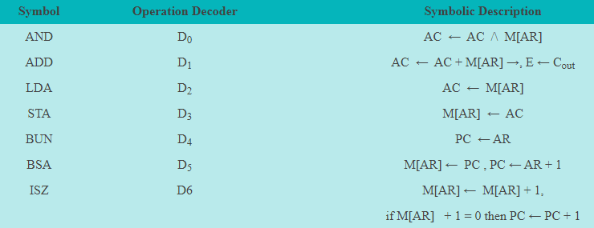

Slide 38
INTERRUPT DESIGN
Interrupt is a special signal , which should be executed immediately by the processor.
When ever the CPU receives the interrupt signal, it stops the execution of the currently running program.
The CPU control will be shifted to interrupt program, once the CPU completes the interrupt program, it control again shifted to the original program.

Slide 39
INTERRUPT DESIGN
We are using a Flip Flop called R is included in the Computer.
When R = 0, the computer goes through an instruction cycle.
When R = 1, the computer goes through an interrupt program.

Slide 40
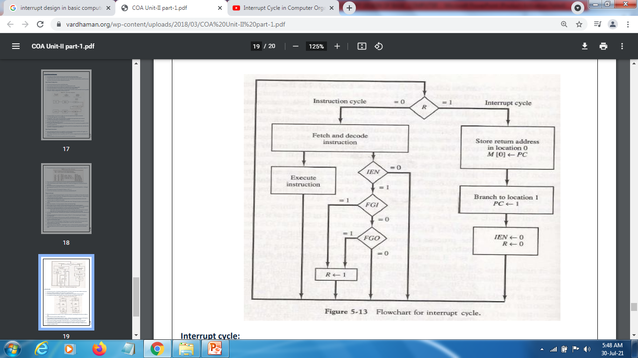
INTERRUPT FLOWCHART

Slide 41
If R=1 interrupt cycle will take place.
Since R=0 Instruction cycle takes place.
The instruction will be fetched , decoded and the instruction will be executed.
While executing the instruction the CPU will check whether there is any interrupt signal or not

Slide 42
To check the interrupt it check IEN flip flop.
Where IEN stands for Interrupt enable flip flop.
Where IEN = 0 (no interrupt)
Where IEN = 1 (interrupt).
When there is interrupt, CPU checks for whether it is FGI (Input interrupt) or FGO (Output interrupt).

Slide 43
When FGI = 1 and FGO = 1 the control is transfer to R and the interrupt cycle will take place inside the CPU.
When ever and interrupt occurs store return address in memory zero.
M[0]<-PC

Slide 44
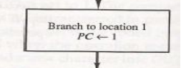
The interrupt related program are stored in memory 1.
Then the interrupt program is shifted to program counter and the interrupt program is executed.

Slide 45

After the execution of the interrupt program the IEN flip flop and R flip flop will becomes zero.

Slide 46
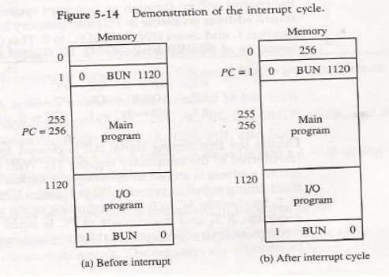
Demonstration of Interrupt cycle with memories

Slide 47
When an interrupt occurs and R is set to 1 while the control is executing the instruction at address 255.
At this time, the returns address 256 is in PC.
The programmer has previously placed an input—output service program in memory starting from address 1120 and a BUN 1120 instruction at address 1.

Slide 48
When control reaches timing signal T0and finds that R = 1, it proceeds with the interrupt cycle.
The content of PC (256) is stored in memory location 0, PC is set to 1, and R is cleared to 0.

Slide 49
The branch instruction at address 1 causes the program to transfer to the input—output service program at address 1120.
Once this is done, the instruction ION is executed to set IEN to 1 (to enable further interrupts), and the program returns to the location where it was interrupted.

Slide 50
INPUT OUTPUT AND INTERRUPT DESIGN
A computer can serve no useful purpose unless it communicates with the external environment.
Instructions and data stored in memory must come from some input device.
Computational results must be transmitted to the user through some output device.

Slide 51
To demonstrate the most basic requirements for input and output communication, we will use as an illustration a terminal unit with a keyboard and printer.

Slide 52
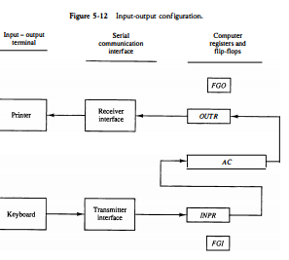

Slide 53
Input-Output Configuration
The terminal sends and receives serial information.
Each quantity of information has eight bits of an alphanumeric code.
The serial information from the keyboard is shifted into the input register INPR.

Slide 54
The serial information for the printer is stored in the output register OUTR.
These two registers communicate with a communication interface with the AC.
The transmitter interface receives serial information from the keyboard and transmits it to INPR. The receiver interface receives information from OUTR and sends it to the printer serially.

Slide 55
The input register INPR consists of eight bits and holds an alphanumeric input information. The 1-bit input flag FGI is a control flip-flop.
Initially, the input flag FGI is cleared to 0. When a key is struck in the keyboard, an 8-bit alphanumeric code is shifted into INPR and the input flag FGI is set to 1.

Slide 56
The computer checks the flag bit; if it is 1, the information from INPR is transferred in parallel into AC and FGI is cleared to 0.
Once the flag is cleared, new information can be shifted into INPR by striking another key.

Slide 57
INPUT-OUTPUT INSTRUCTION
Just like the Register-reference instruction, an Input-Output instruction does not need a reference to memory and is recognized by the operation code 111 with a 1 in the leftmost bit of the instruction.
The remaining 12 bits are used to specify the type of the input-output operation or test performed.

Slide 58
INPUT-OUTPUT INSTRUCTION
Input-output instructions have an operation code 1111 and are recognized by the control when D7 = 1 and I = 1.

Slide 59
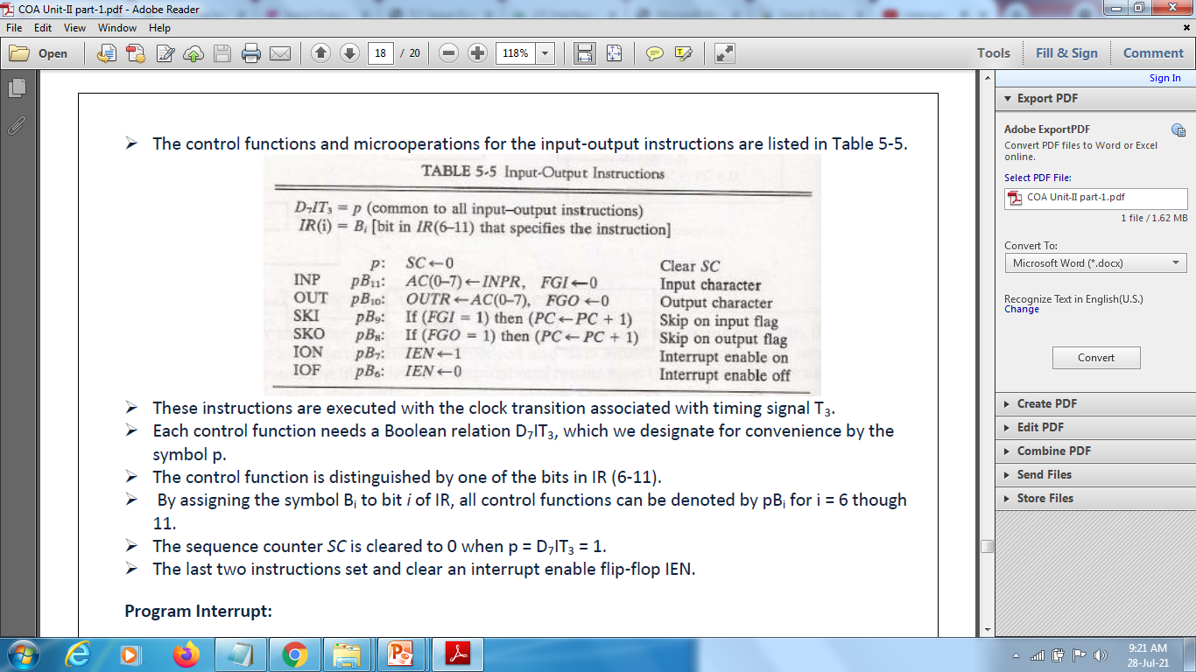
The control functions and microoperations for the input-output instructions are listed

Slide 60
Register files
A register file is an array of processor registers in a central processing unit (CPU). Modern integrated circuit-based register files are usually implemented by way of fast static RAMs with multiple ports.
A register file is a means of memory storage within a computer's central processing unit (CPU).
The computer's register files contain bits of data and mapping locations. These locations specify certain addresses that are input components of a register file(RF).
RF requires two or three operands to be accessible simultaneously. It needs several access ports for simultaneously reading from writing to several location.
A register file is often realized as a multiport RAM .

Slide 61
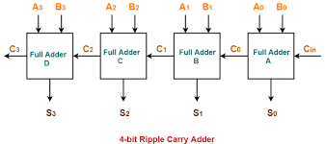
ALU Expansion
It is feasible to manufacture an entire sequential ALU for fixed point m bit numbers on a single IC chip.
The ALU can easily be designed for expansion to handle operands of size =n=km or any word size n > m and is done in two ways.
Spatial expansion (bit sliced ALU): Connect k-copies of m-bit ALU in the manner of a ripple carry adder to form a single ALU capable of processing km bit words directly. The resulting circuit is said to be bit sliced because each block of ALU concurrently processes a separate "slice" of m bits from each of the km bit operands.

Slide 62
Temporal Expansion (Multi-cycle ALU)
Use one copy of m-bit ALU chip to perform operations on km-bit words in k consecutive steps i.e. k clock cycles. In each step, the ALU processes a separate m bit slice of each operand. Hence this processing is called multi-cycle.
Bit sliced ALU:
Bit slicing is a method of combining processor modules to multiply the word length. In a bit-sliced processor, each module contains an ALU (arithmetic-logic unit) usually capable of handling a 4-bit field.

Slide 63
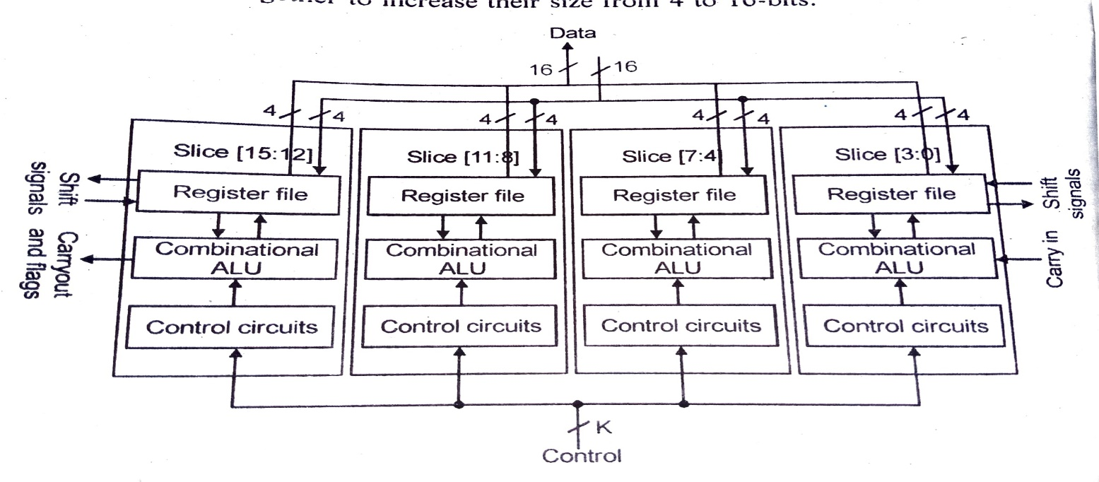
16 bit ALU composed of four 4 bit slices

